Slide 1


DISCOVER
EXPLORE
ENVISION
SHORES PARK
THE CITY OF DEL MAR
DEL MAR CITY COUNCIL MEEING
“EXPLORE” PHASE
January 19, 2016

Slide 2
AGENDA
PROJECT PROCESS AND SCHEDULE
“DISCOVER” AND “EXPLORE” PHASES AND RESULTS
DRAFT PARK PROGRAM ALTERNATIVES
CONCLUSION AND DISCUSSION

Slide 3
1
PROJECT PROCESS AND SCHEDULE
DISCOVER
Spring 2015 – Community-Wide Survey, Pop-up Events, and 20 Interest
Group Interviews, Park and Recreation Commission,
Shores Park Advisory Committee, City Council
May 2, 2015 – Workshop #1 “Plan Your Park” Event
EXPLORE
Fall 2015 – Pop-up Events
October 18th – Workshop #2 “Design Your Park” Event
December 9th – SAC Meeting (review refined program)
January 19th – City Council Meeting (present refined program)
ENVISION
Winter/Spring 2016 – SAC Meeting (Preview master plan alternatives)
Winter/Spring 2016 – Workshop #3 “Master Plan Alternatives”
Winter/Spring 2016 – SAC Meeting (report results & review next steps)
Summer 2016 – SAC (Preview preferred plan)
Summer 2016 – Workshop #4 Present “Refined Park Plan”

Slide 4

2
DISCOVER & EXPLORE PHASES
COMMUNITY-WIDE SURVEY
Conducted by True North Consulting March-April 2015
Community Survey Goals:
Gather information to help inform the Shores Park Master Plan
Profile recreational interests and activities of Del Mar residents
Measure use and perceptions of Del Mar parks in general, as well as Shores Park in particular.
Identify the types of amenities and improvements to Shores Park that are priorities for Del Mar residents.
Understand how the above may vary across subgroups.

Slide 5
INTEREST GROUP INTERVIEWS
A total of 20 interest group interviews held between January and May of 2015.
Jan 12, 2015 Farmers Market
Jan 12, 2015 Garden Club Interest Group
Jan 14, 2015 Del Mar Community Connections (DMCC)
Jan 14, 2015 Historical Society
Jan 14, 2015 Friends of Del Mar Parks
Jan 14, 2015 Park & Recreation Staff
Jan 14, 2015 Youth Sports Groups
Jan 15, 2015 Del Mar Foundation
Jan 22, 2015 Del Mar Village Association (DMVA)
Jan 22, 2015 Dog Owners
Feb 9, 2015 Parents/Young Del Mar/PTA
Feb 19, 2015 Sustainability Advisory Board
March 31, 2015 Adjacent Commercial Property Owners and Businesses
March 31, 2015 Adjacent Residential Property Owners
April 13, 2015 Winston School
May 6, 2015 Community Services Department Staff
May 6, 2015 Public Works Department Staff
May 6, 2015 Youth Sports Organizations (conference call)
May 12, 2015 Alvarado House Tour
May 13, 2015 Clean Water Program Manager (conference call)

Slide 6
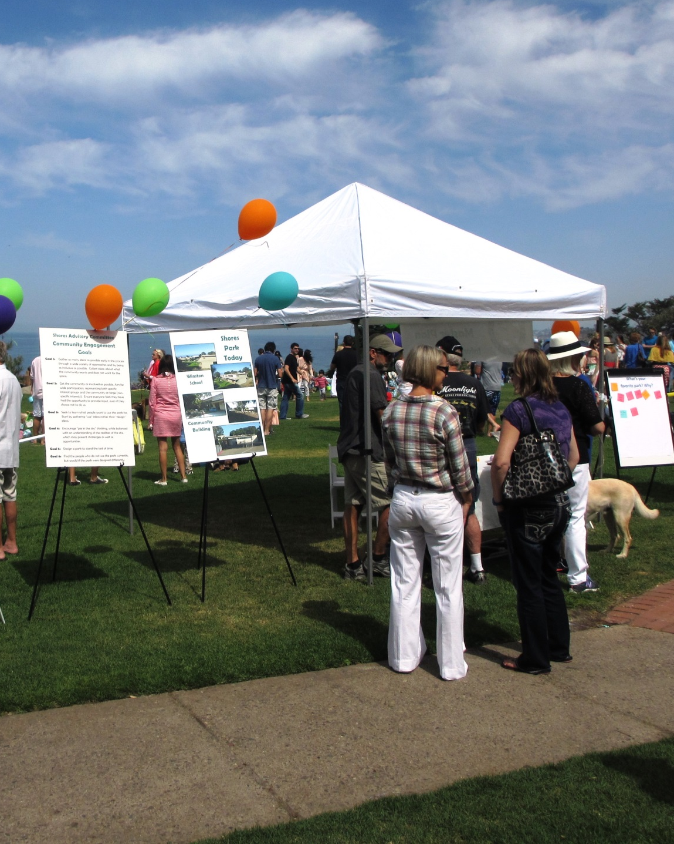
POP-UP EVENTS
  Egghunt Event - April 4th, 2015
  Farmer’s Market – April 18, 2015
  Farmer’s Market – October 3, 2015
  Art Stroll – October 4, 2015
  Feedback was tallied from notations made by community members in response to open-ended questions regarding favorite parks, possible amenities for Shores Park, and preferred recreational activities. There were no formal inquiries made regarding residency. However, anecdotally, the majority of feedback was from Del Mar residents.

Slide 7
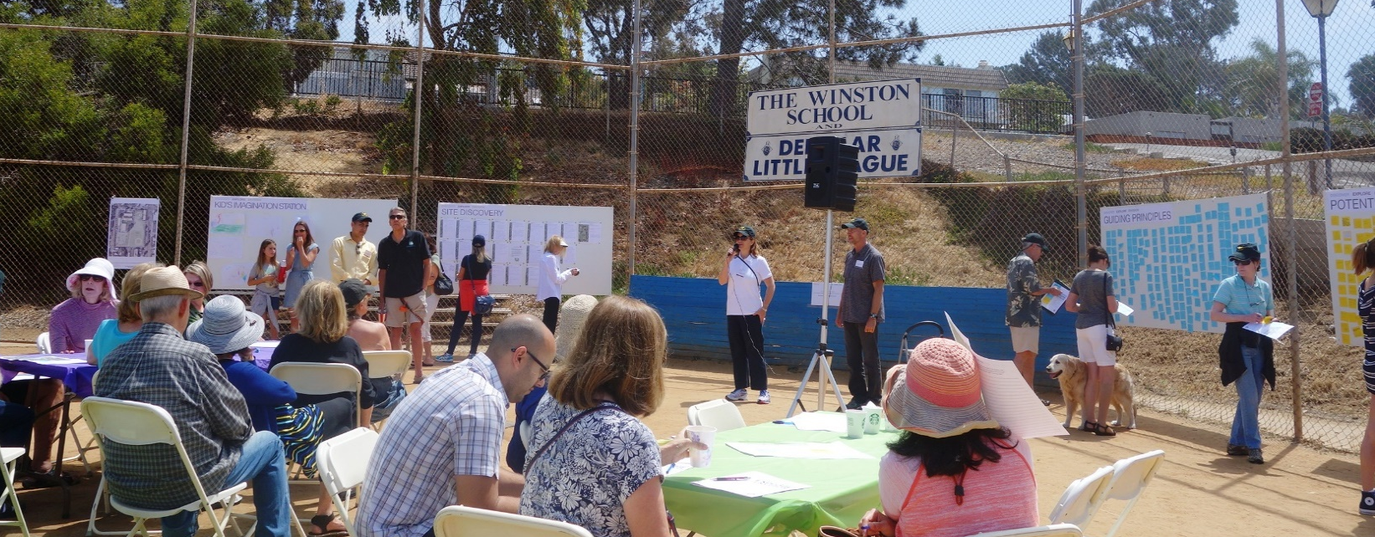
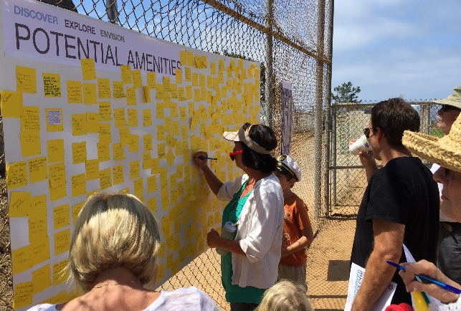
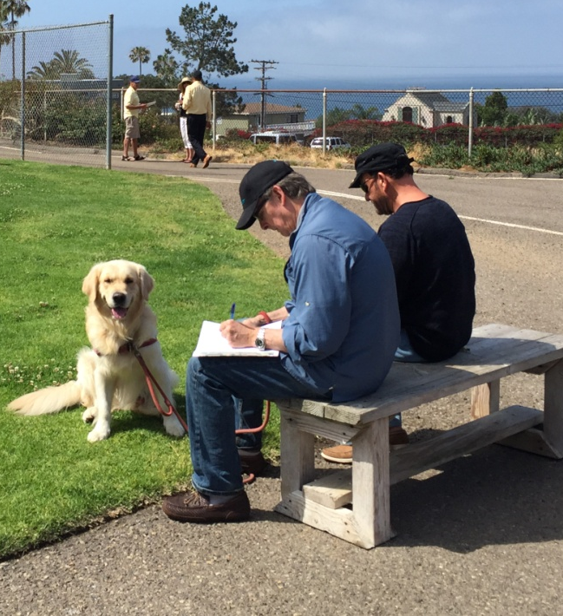
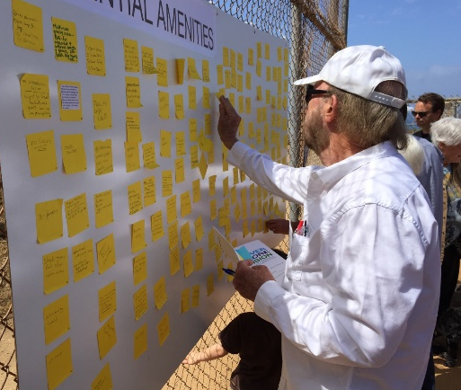
COMMUNITY WORKSHOP #1
May 2, 2015
Walking tour of the site, identification of opportunities and constraints. Guiding Principles exercise, Potential Amenities exercise.

Slide 8
GUIDING PRINCIPLES
Provide a beautiful and peaceful neighborhood park environment that serves the residents of Del Mar.
Create an inclusive space that offers recreational opportunities for all ages.
Thoughtfully integrate the needs and desires of residents visiting the park with or without pets.
Capture the dramatic views to the Pacific Ocean.
Provide a gardenesque park setting that is environmentally and economically sustainable.
Integrate the activities, program, circulation, and recreational needs of the Winston School.
Create a park that reflects the rich history, unique culture, and community character of Del Mar.

Slide 9
POTENTIAL AMENITIES
Tier I Potential Amenities
Attractive gardens and landscaping
(low water use/sustainable)
Benches for sitting, enjoying views, reading, meditating, etc.
Fully accessible for visitors with disabilities
Furnishings such as trash and recycling receptacles, drinking fountains, bike racks, etc.
Grassy areas for off leash dog activities (no obvious or rigid fences)
Open turf for flexible play (also addresses Winston School lease requirement)
Indoor meeting/recreational community space
Parking to meet building code
Accommodate children’s activities
Picnic Area(s)
Restroom
Shade
Walking Paths

Slide 10
POTENTIAL AMENITIES
Tier II Potential Amenities
Basketball (half court)
Multi-Purpose Court (basketball/pickle ball/tennis etc.)
Children’s Playground
Outdoor Fitness Course

Slide 11
POTENTIAL AMENITIES
Tier III Potential Amenities
Amphitheater
Auditorium (Joint-use with Winston School)
Community Garden
Interpretive Education (plant ID tags, education signage, etc.)
Sports Fields (Youth Baseball/Softball)
Bocce Ball

Slide 12
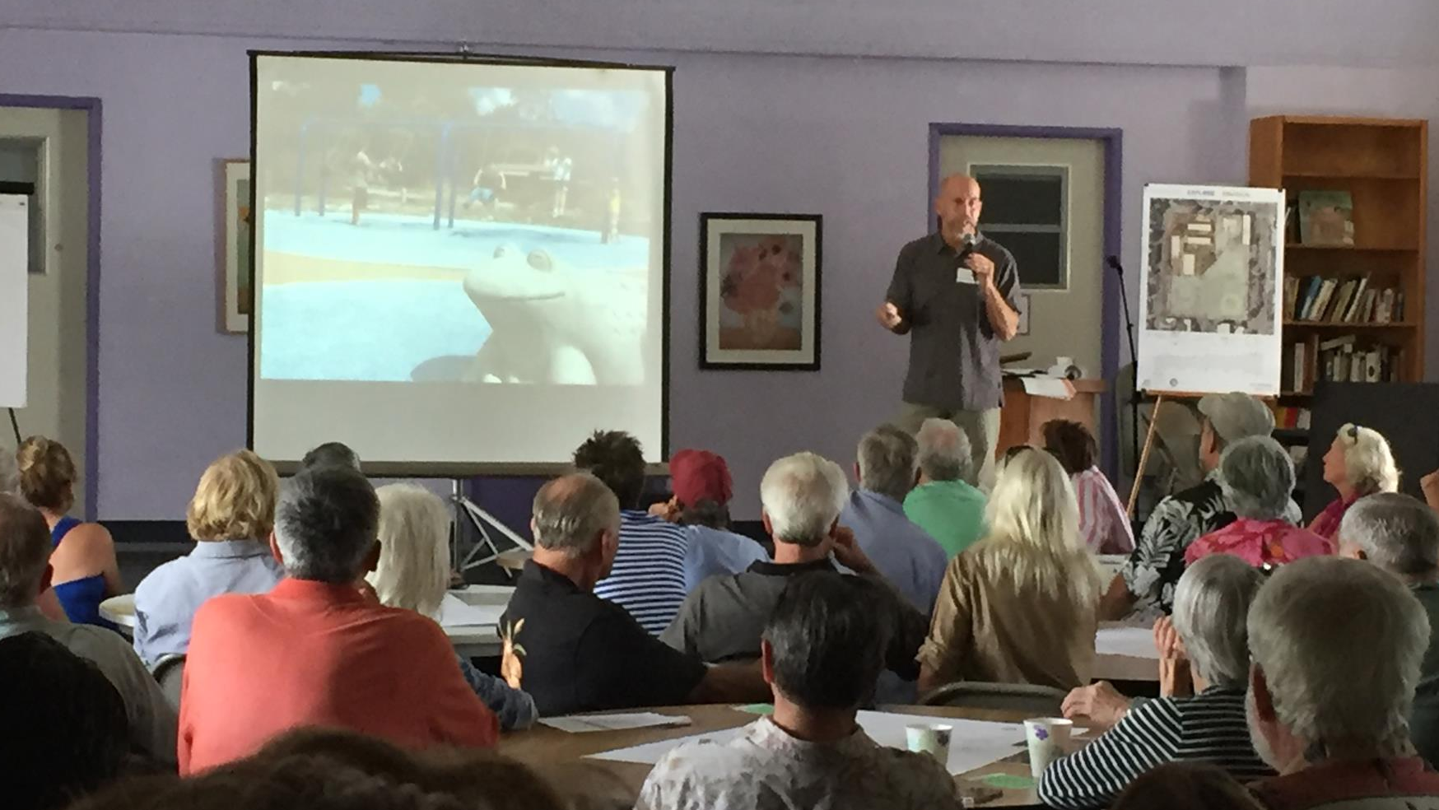
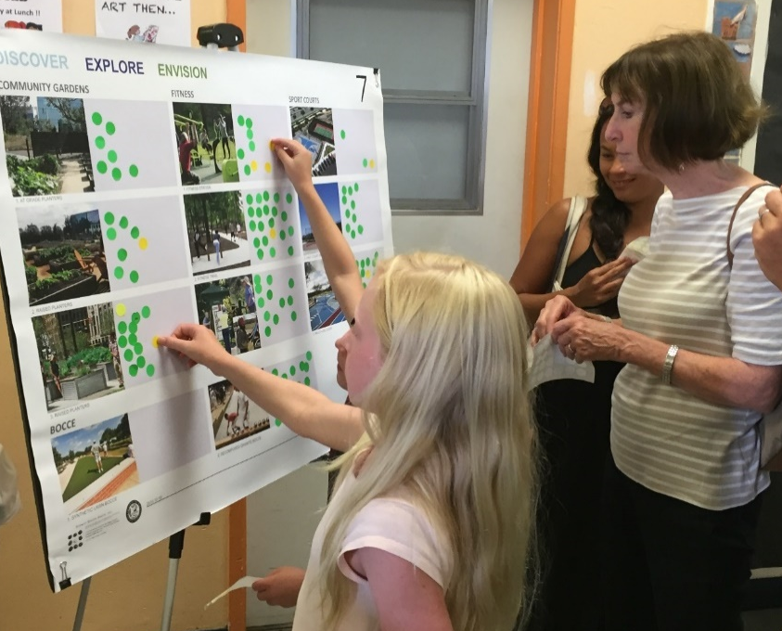
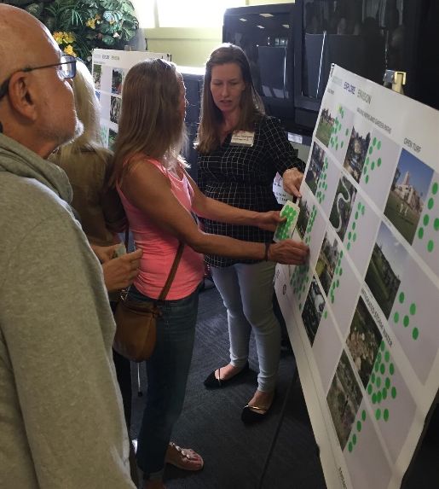
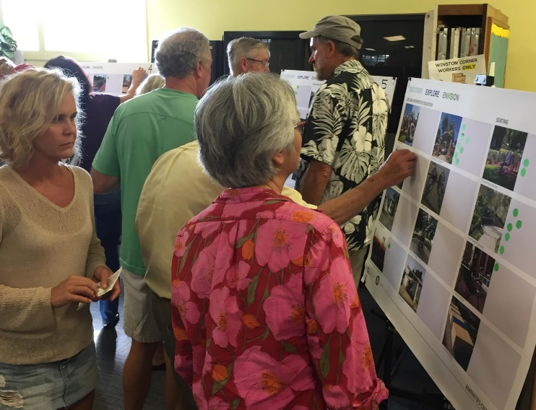
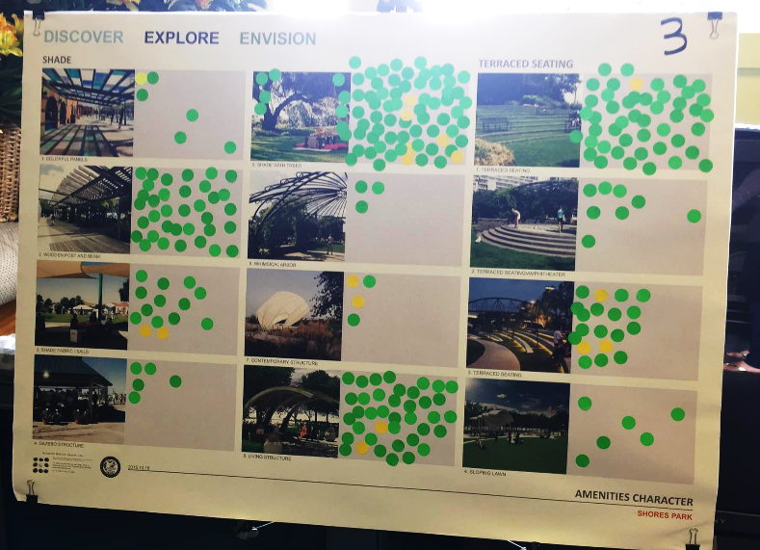
October 18, 2015
Design character exercises, case studies
COMMUNITY WORKSHOP #2

Slide 13
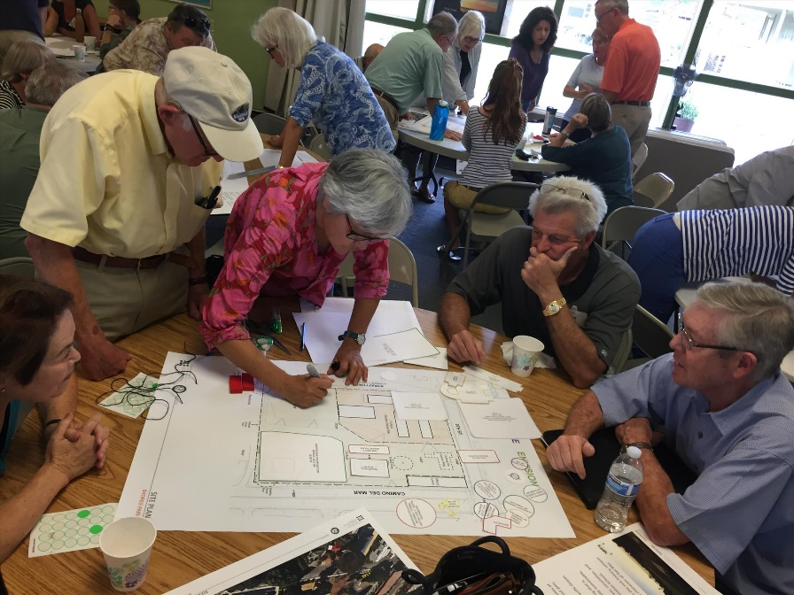
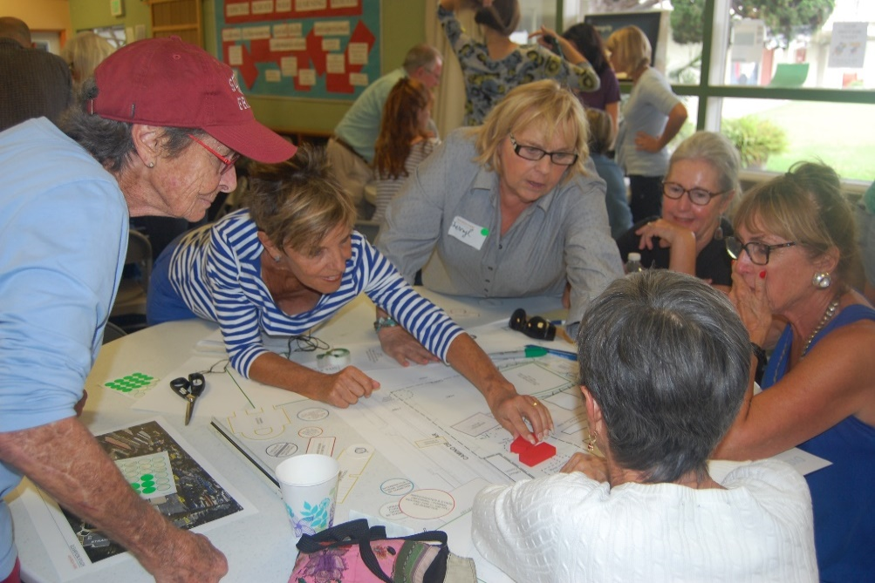
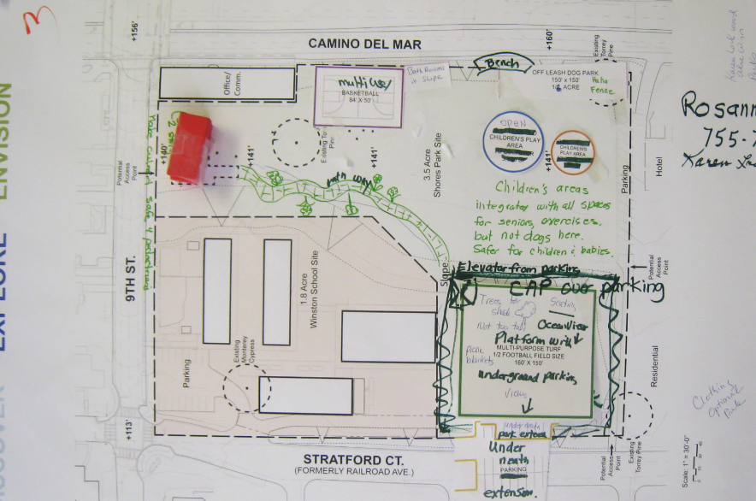
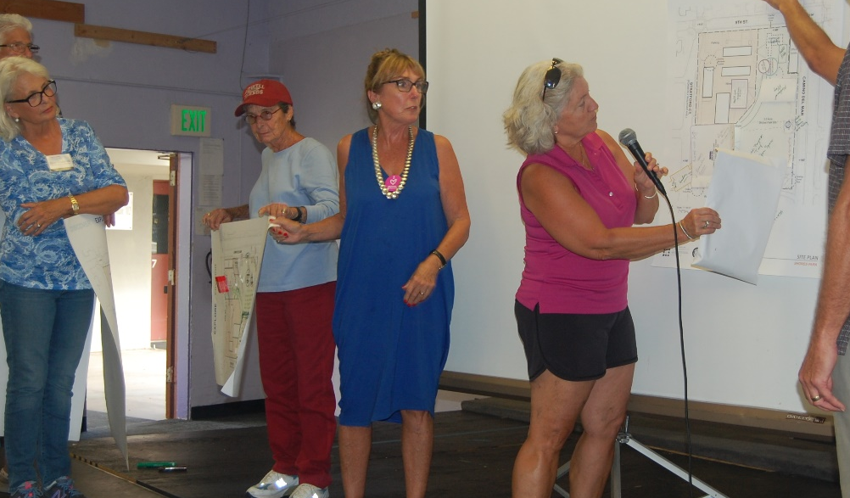
October 18, 2015
Design your park exercise
COMMUNITY WORKSHOP #2

Slide 14
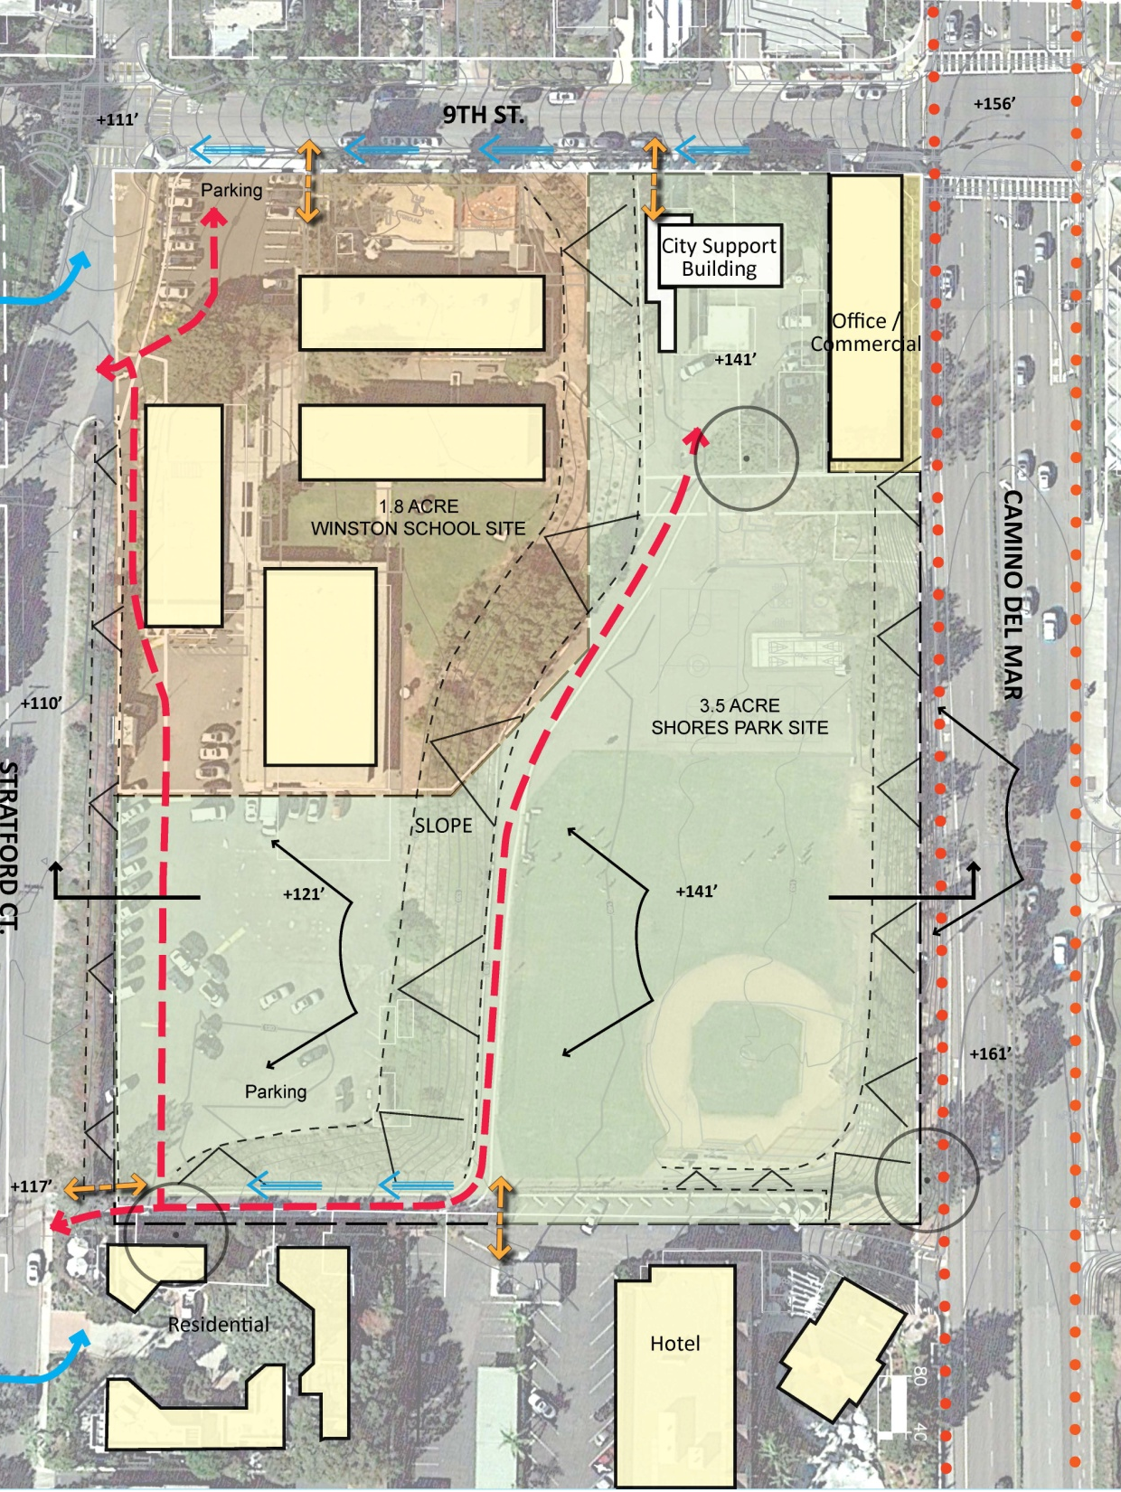









SITE ANALYSIS
LEGEND
SECTION LINE
PREVAILING WINDS
VEHICULAR CIRCULATION
PEDESTRIAN ENTRY WAY
VIEW SHED
EXISTING SLOPES
STORMWATER
BIKE LANE
EXISTING TORREY PINE

Slide 15
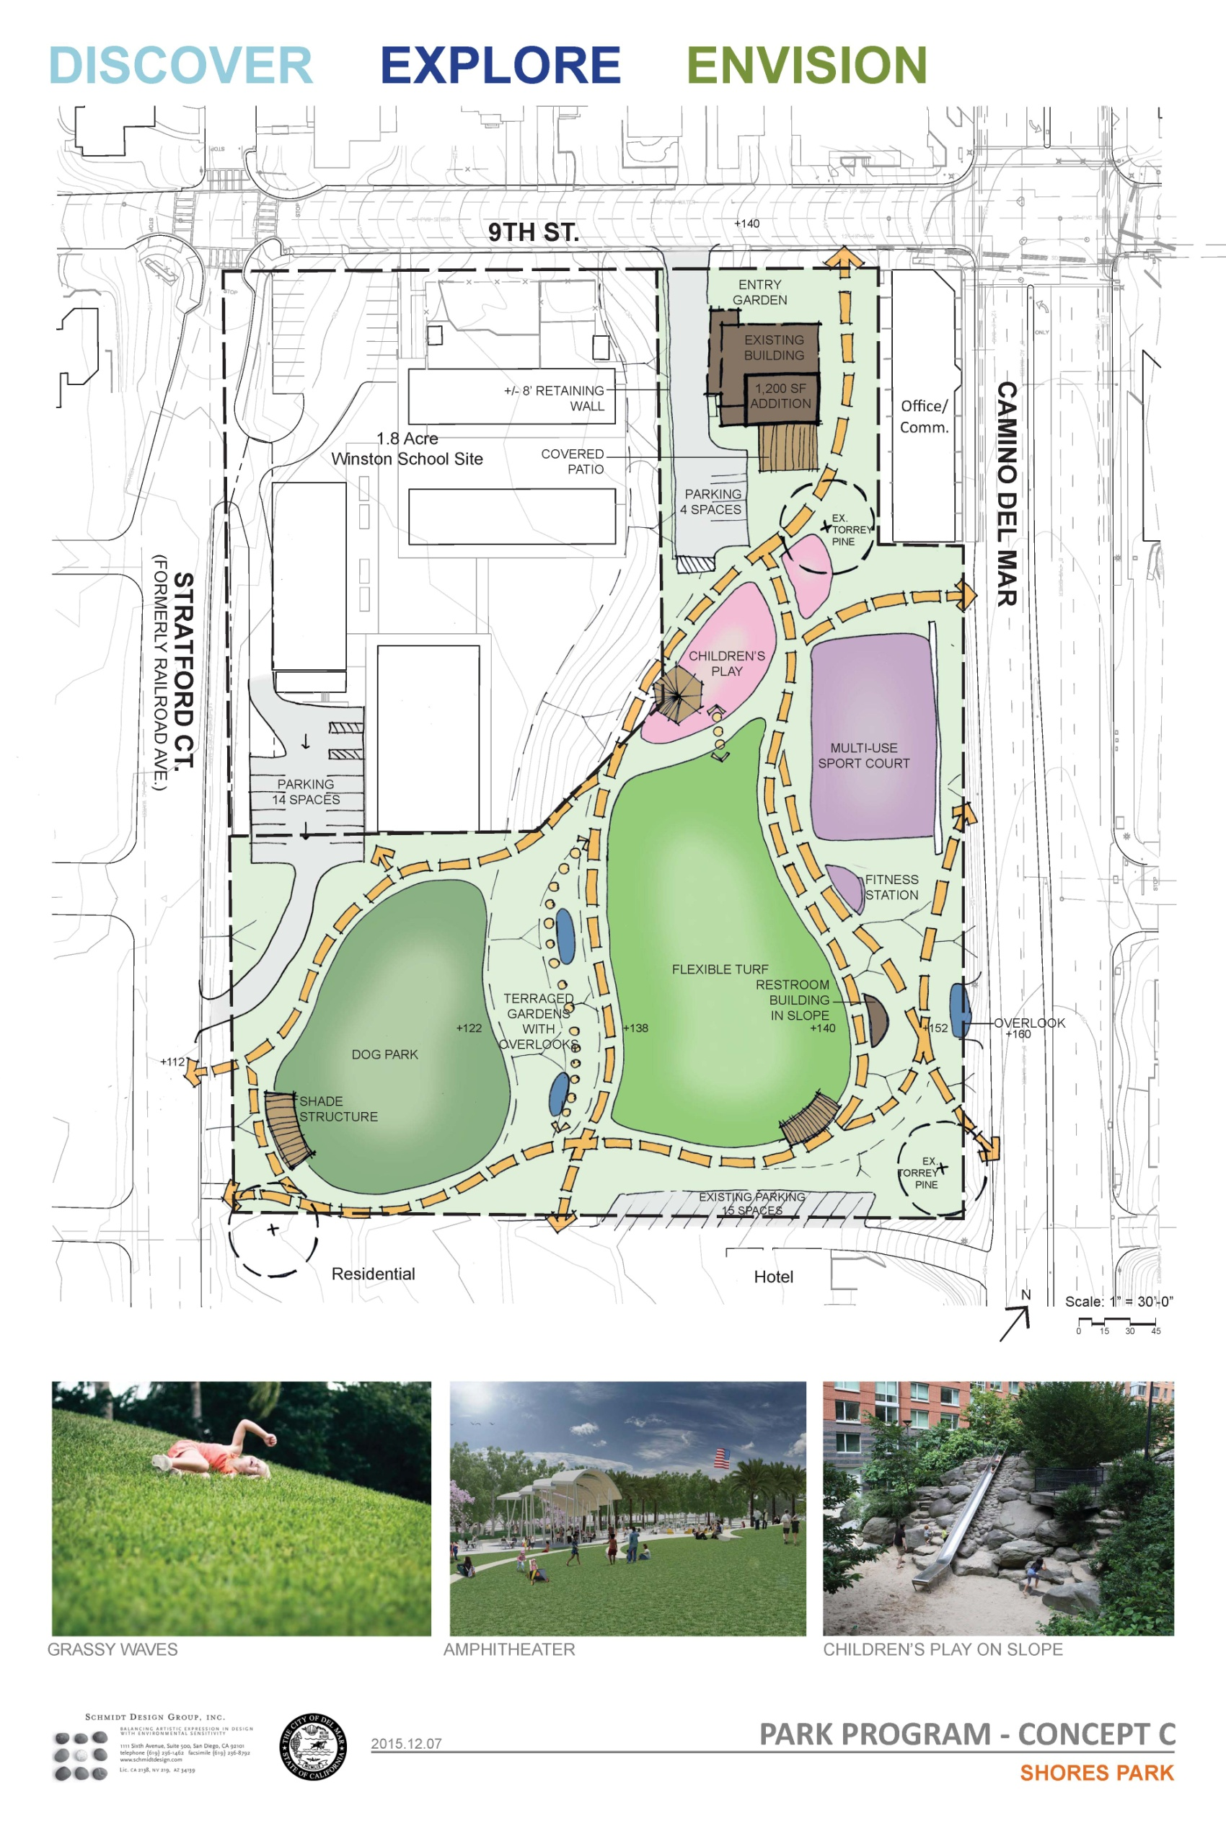
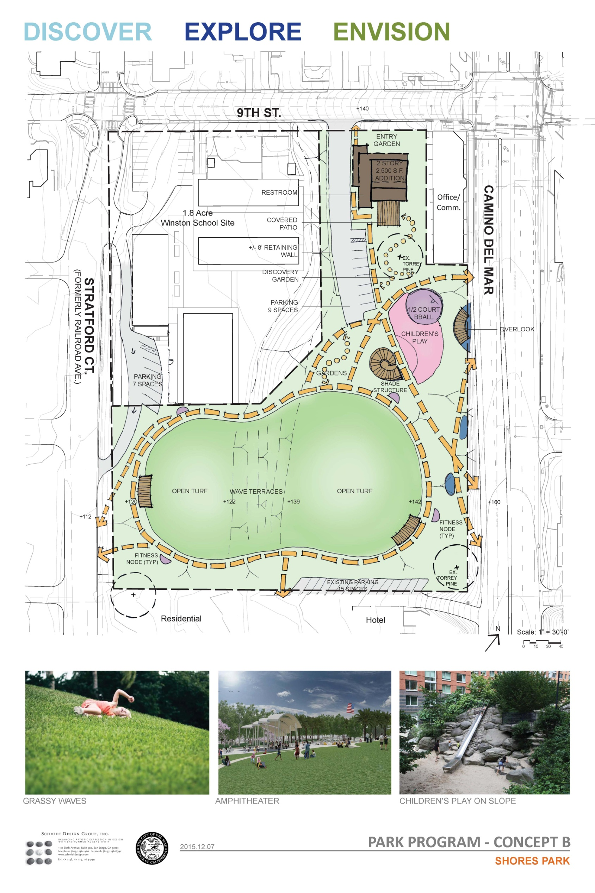
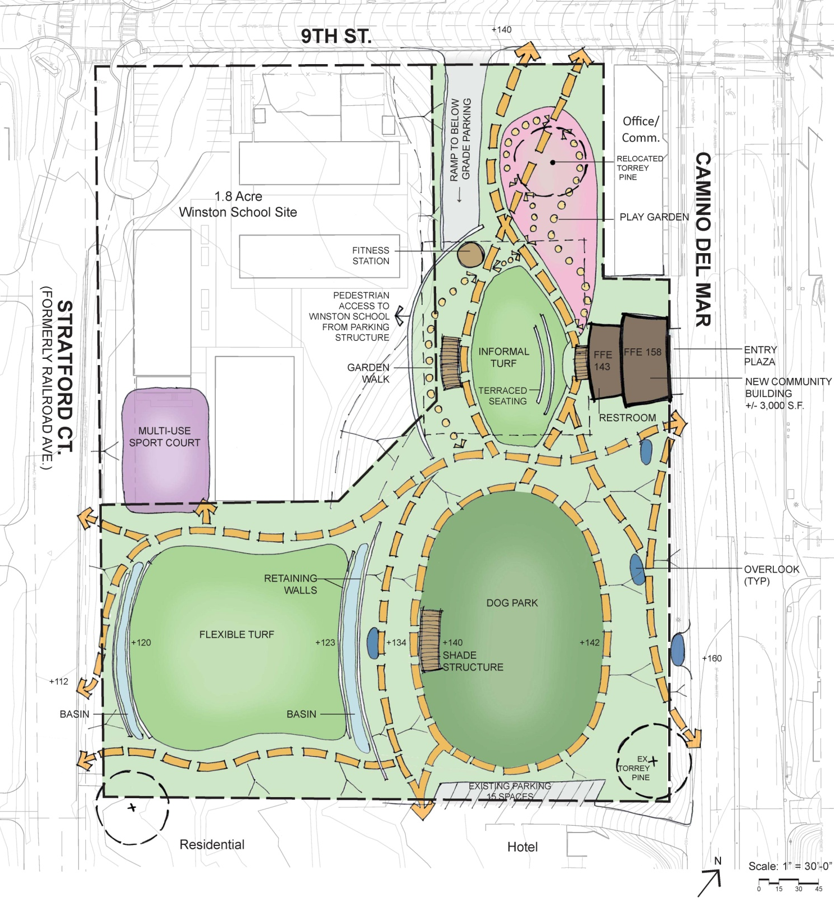
3
DRAFT PARK PROGRAM ALTERNATIVES
“Bubble Diagrams”
Draft Concept A
Draft Concept B
Draft Concept C
Our goal is to affirm that the three draft program alternatives that have been developed represent what has been heard from community feedback and direction up to this point.

Slide 16

DRAFT PARK PROGRAM
Draft Concept A

Slide 17
DRAFT PARK PROGRAM
Draft Concept A – Amenities Summary
Existing Community Building with addition to accommodate indoor meeting/recreational space, restroom (1,200sf addition)
Parking with access from 9th and Stratford (4 handicap spaces), school parking 14 spaces at south side, 15 spaces near hotel (33 total)
Garden pathways with benches for sitting, enjoying views, reading, meditating, etc.
Off leash dog area (no obvious or rigid fences) at lower level
Open turf for flexible play
Natural children’s play elements
Trees and structures for shade
Restroom integrated into the slope
Multi-use sport court
Fitness Stations
TIER 1
TIER 2
TIER 3
Interpretive Education (plant ID tags, education signage, etc.)

Slide 18
Draft Concept A

Slide 19
Draft Concept A

Slide 20
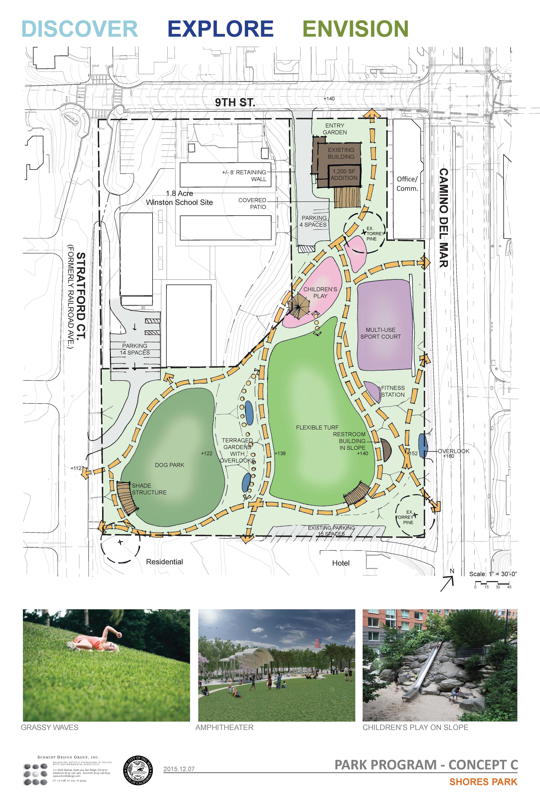
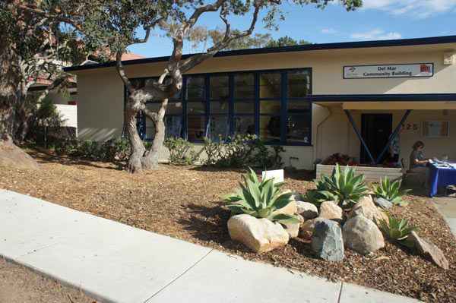
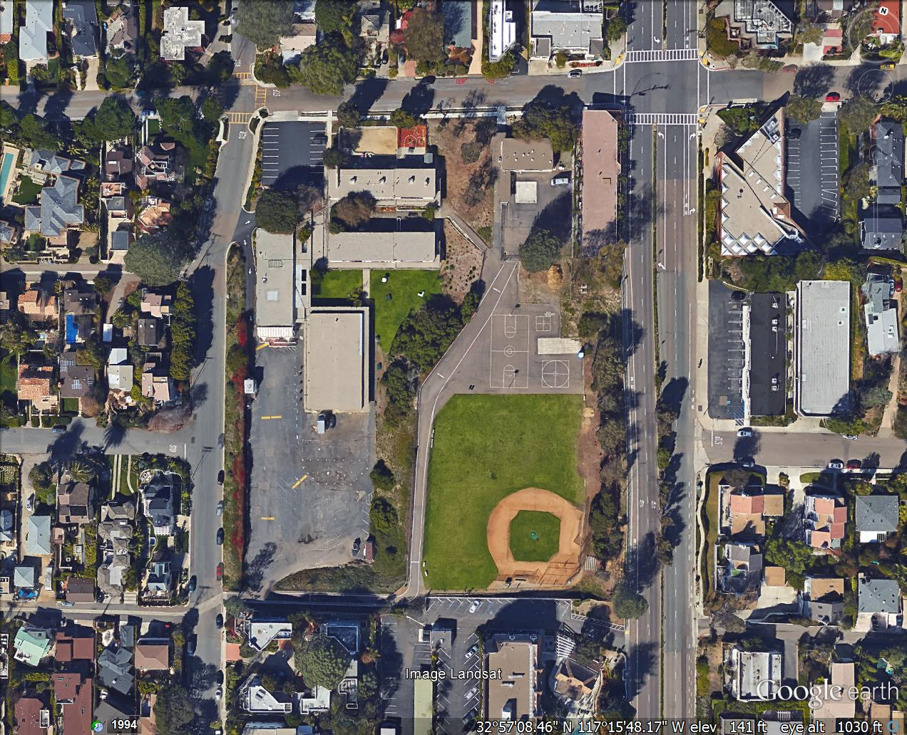
Draft Concept A

Slide 21
Draft Concept A

Slide 22
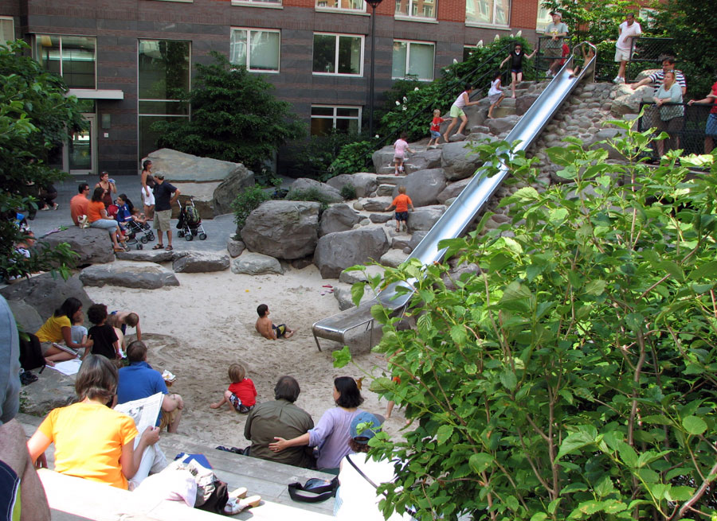
Architect: Michael Van Valkenburgh Associates. Photo Credit: Natural Learning Initiative

Slide 23
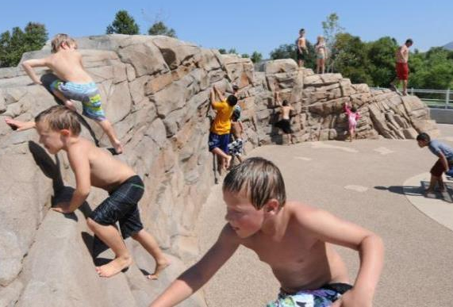
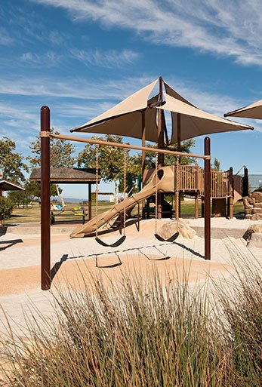
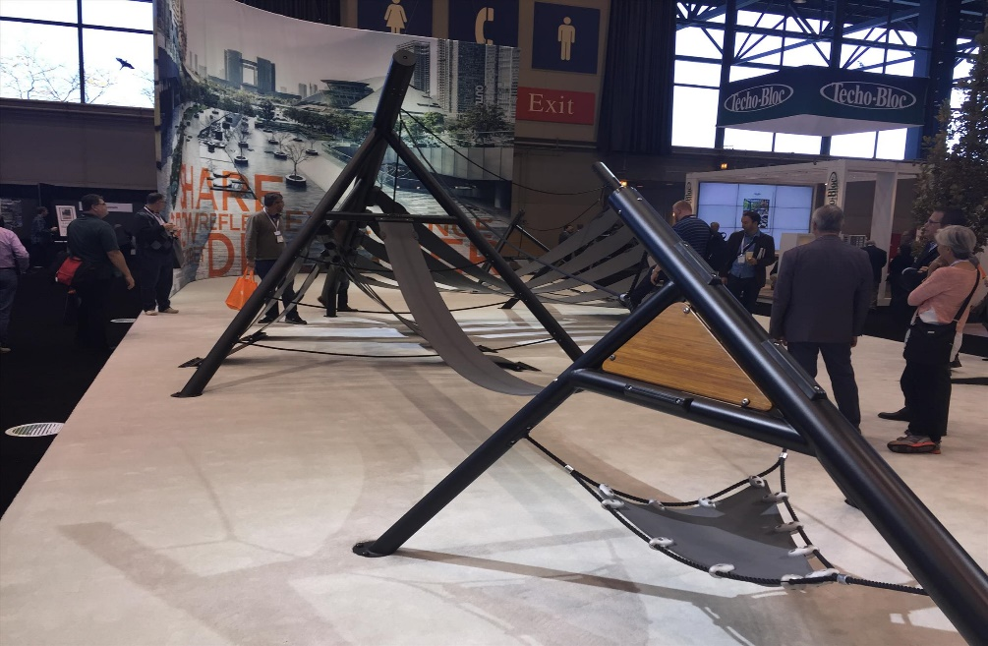

Slide 24
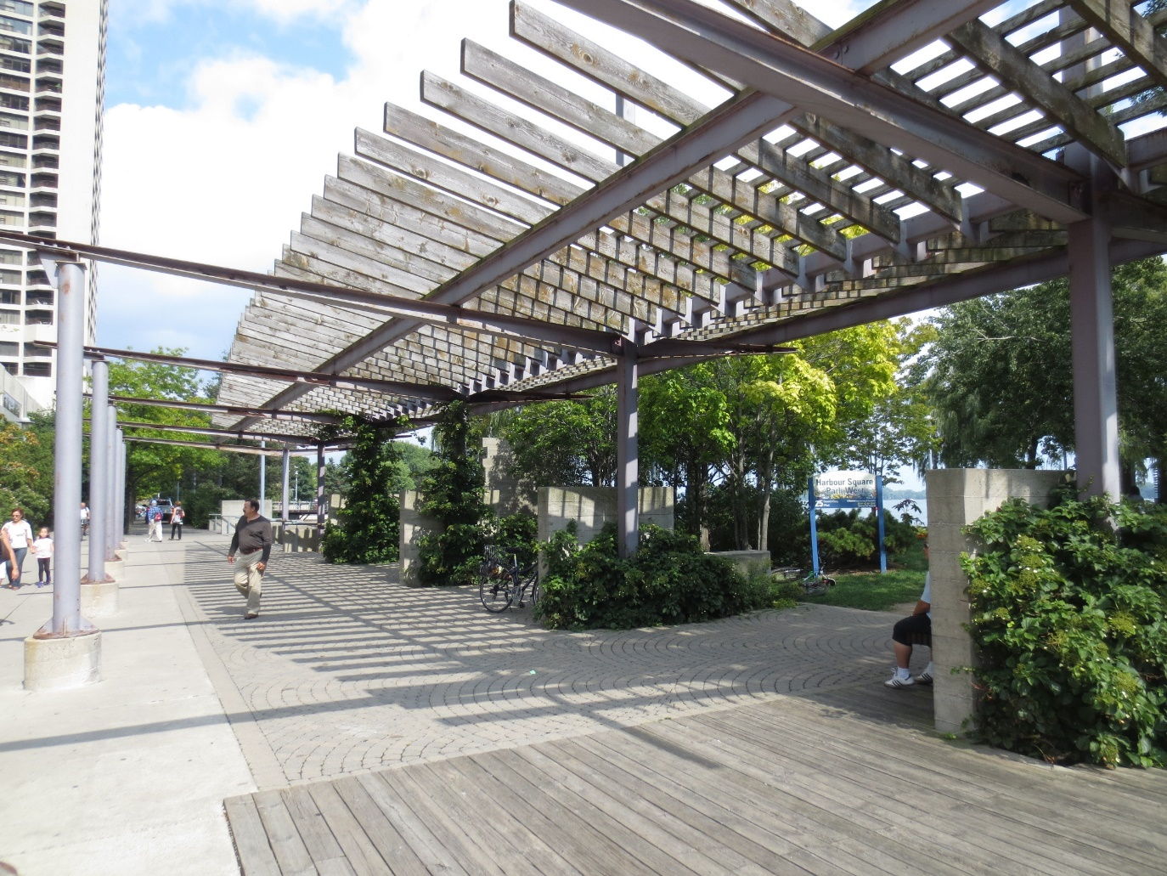
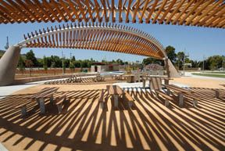
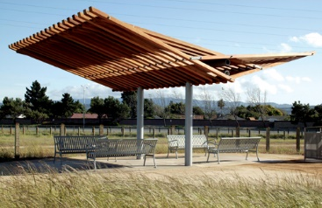
Architect: Enderstudio
Architect: Enderstudio

Slide 25
Draft Concept A

Slide 26
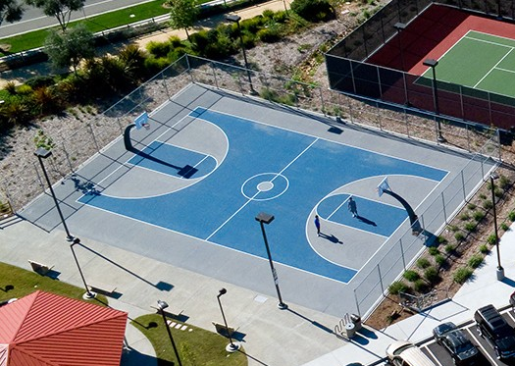
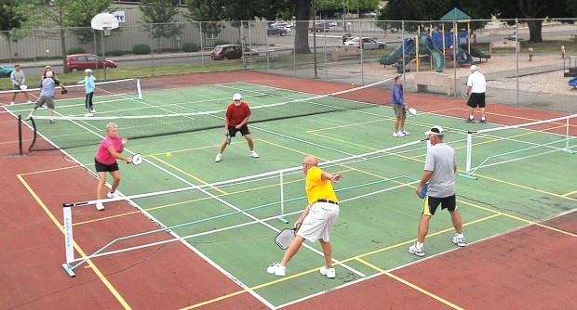
Photo Credit: Mark Ylen/Democrat Herald

Slide 27
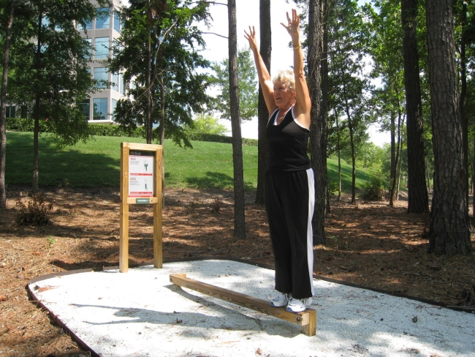
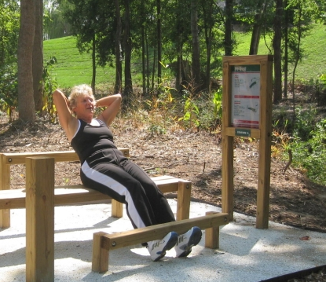
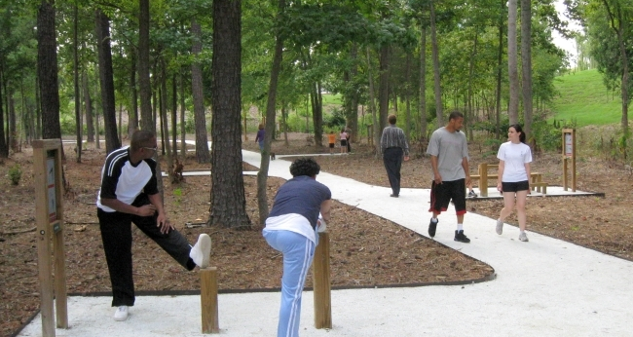
Notes:
http://www.fittrail.com/
http://www.gfoutdoorfitness.com/img/large/Senior_Fitness.jpg

Slide 28
Draft Concept A

Slide 29
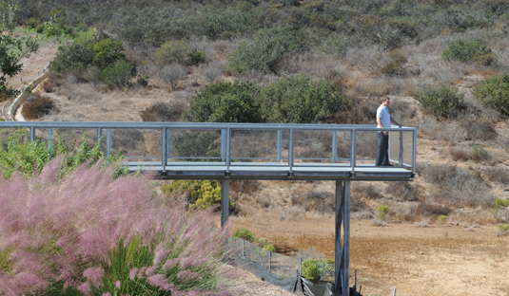
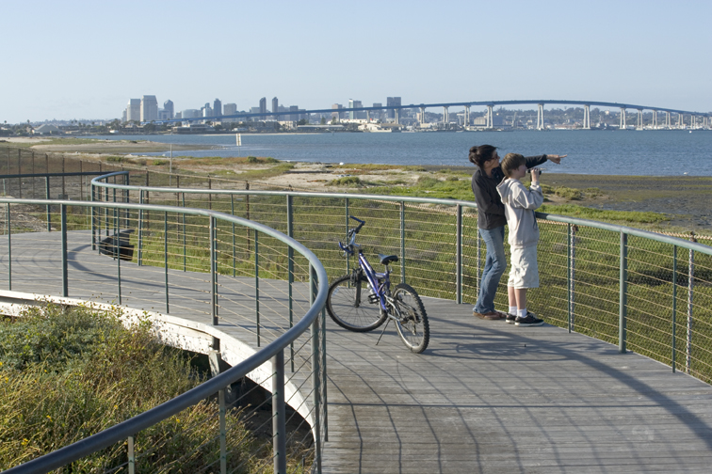

Slide 30
Draft Concept A
4 Parking Spaces
14 Parking Spaces
15 Parking Spaces
Parking - 33 Total

Slide 31
Draft Concept A

Slide 32
215’ x 175’

Slide 33
Draft Concept A
240’ x 130’
175’ x 130’
(Existing 215’ x 175’)

Slide 34
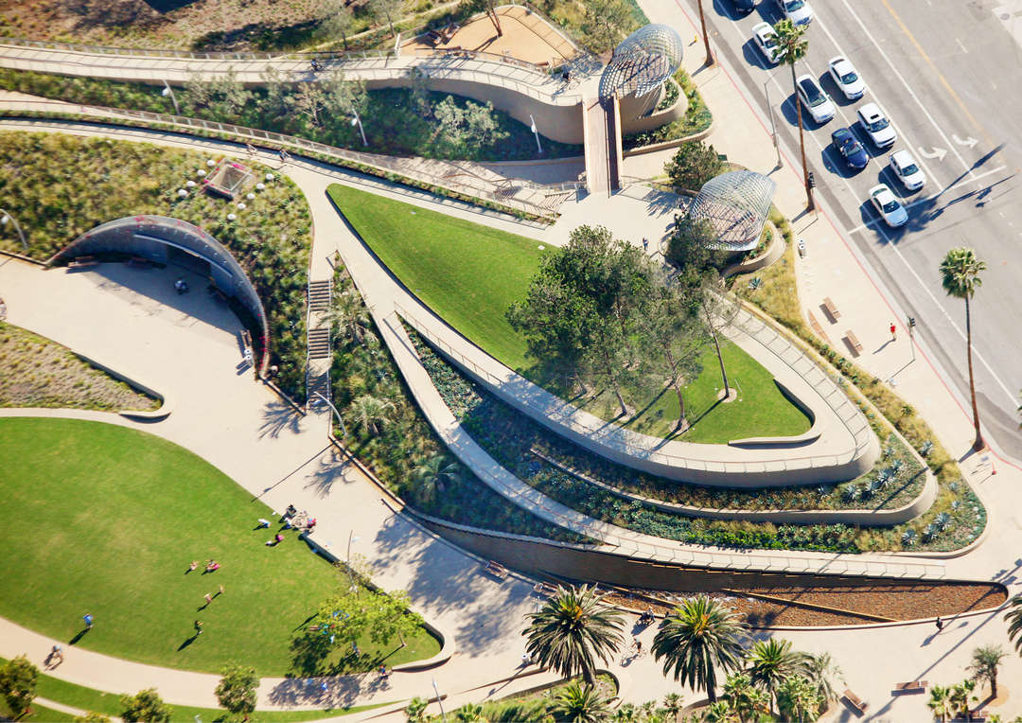
Architect: Design Workshop

Slide 35
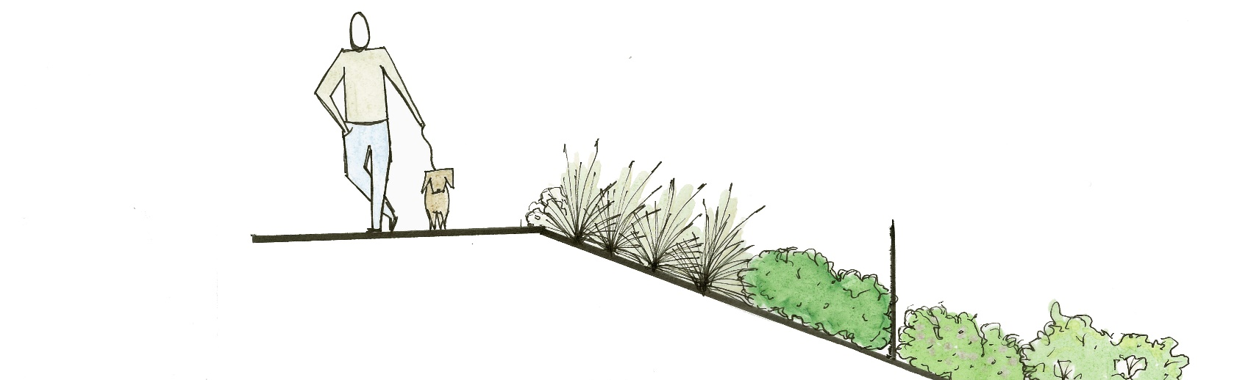
FENCE DOWN SLOPE
“Ha-Ha” Fence on Slope
Notes:
Edge treatment

Slide 36
Draft Concept A

Slide 37
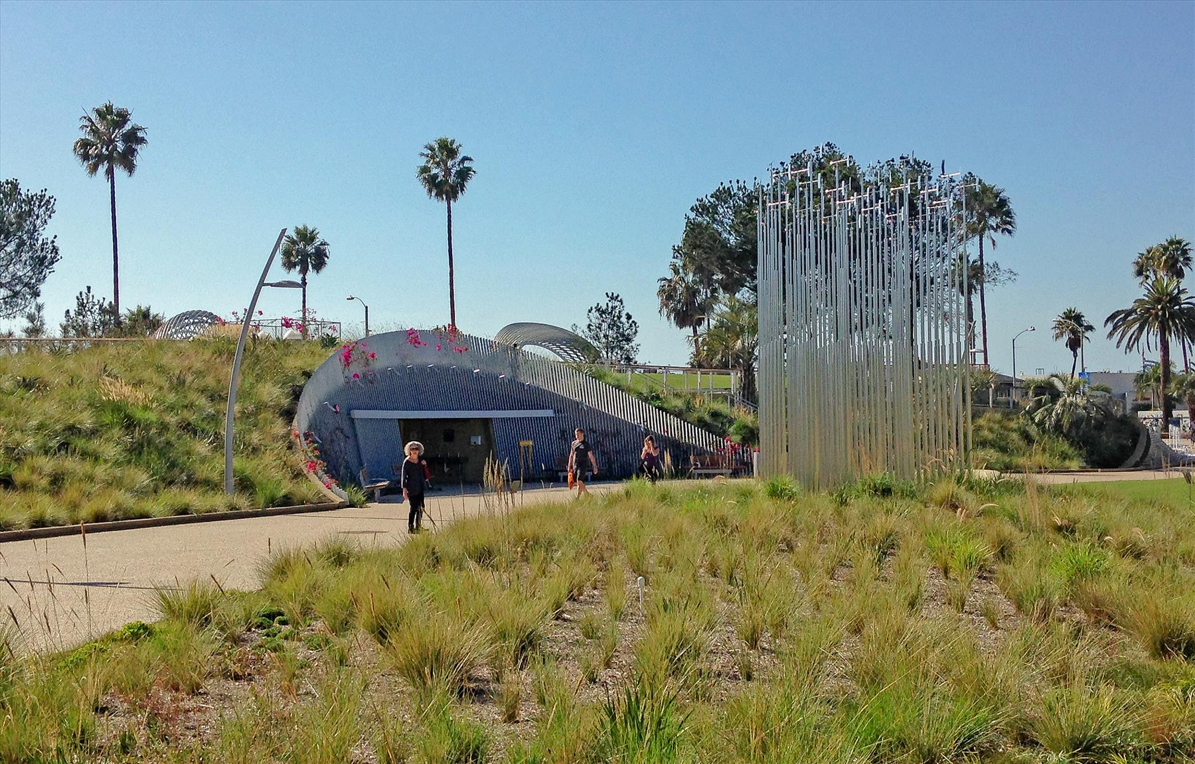
Architect: Design Workshop

Slide 38
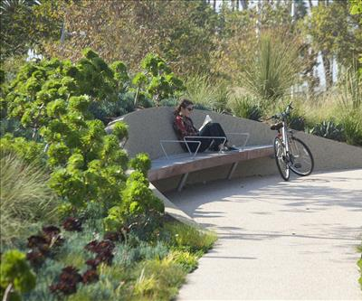
Architect: Design Workshop. Photo Credit: Tim Porter

Slide 39
Draft Concept A

Slide 40

DRAFT PARK PROGRAM
Draft Concept B

Slide 41
DRAFT PARK PROGRAM
Draft Concept B – Amenities Summary
Existing Community Building with second story addition to accommodate indoor meeting/recreational space, restroom, and rooftop terrace (2,500sf addition)
Parking with Access from 9th (9 spaces), school parking 7 spaces at south side, 15 spaces near hotel (31 total)
Garden Pathways with benches for sitting, enjoying views, reading, meditating, etc.
Open turf for flexible play with shared off-leash dog use
Trees and structures for shade
Restroom located in existing building
Half-court basketball
Natural children’s play ground
Fitness stations
Informal Amphitheater
TIER 1
TIER 2
TIER 3
Interpretive Education (plant ID tags, education signage, etc.)

Slide 42
Draft Concept B

Slide 43
Draft Concept B

Slide 44
Draft Concept B

Slide 45
Draft Concept B

Slide 46
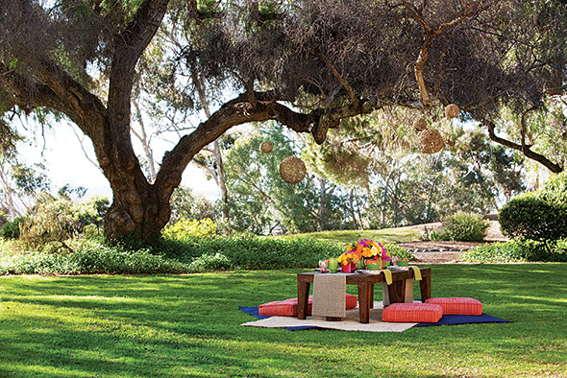
Photo Credit: Terri Rippee
Notes:
http://www.sandiegomagazine.com/

Slide 47
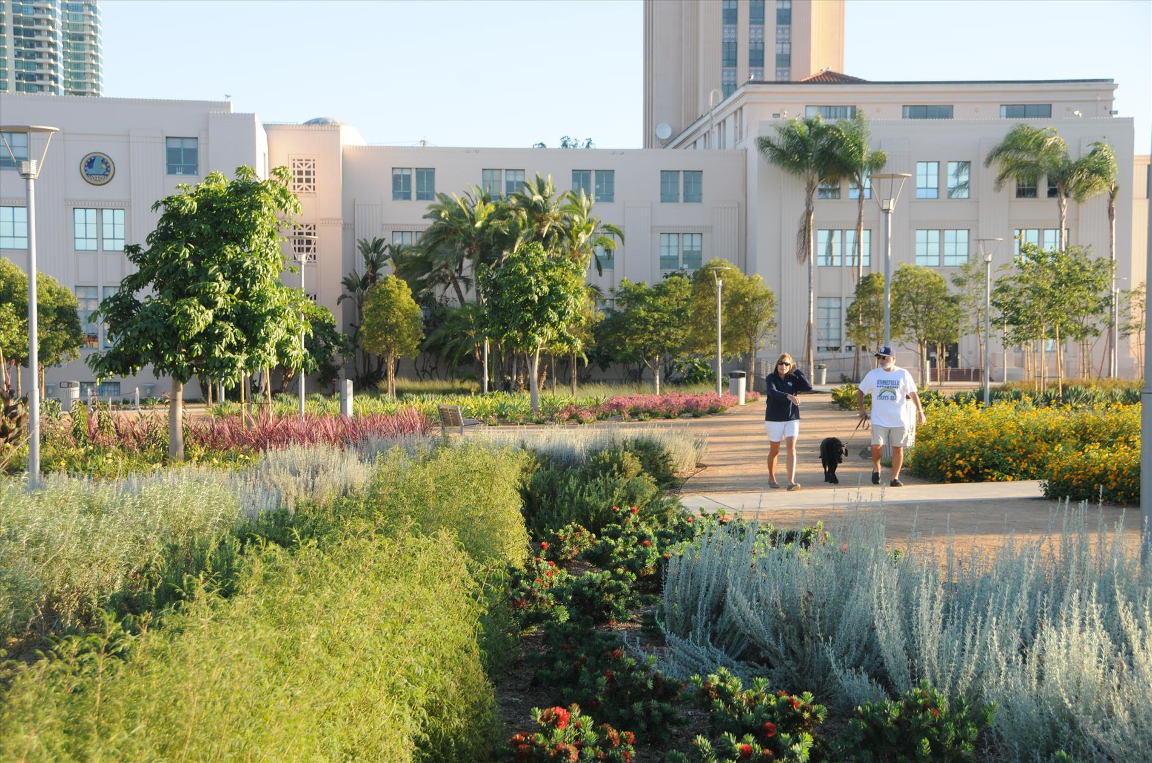

Slide 48
Draft Concept B

Slide 49
Draft Concept B

Slide 50
Architect: Michael Van Valkenburgh Associates. Photo Credit: Natural Learning Initiative

Slide 52
Architect: Enderstudio
Architect: Enderstudio

Slide 53
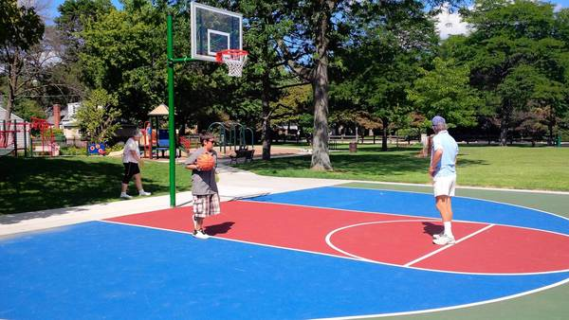
Photo Credit: Susan Berger/Chicago Tribune

Slide 55
Draft Concept B
9 Parking Spaces
7 Parking Spaces
15 Parking Spaces
Parking - 31 Total

Slide 56
Draft Concept B

Slide 57

Draft Concept B
200’ x 150’
170’ x 115’
340’
(Existing 215’ x 175’)

Slide 58
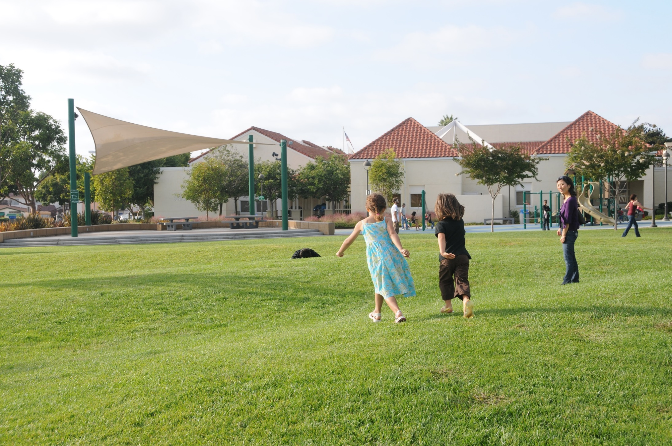

Slide 59
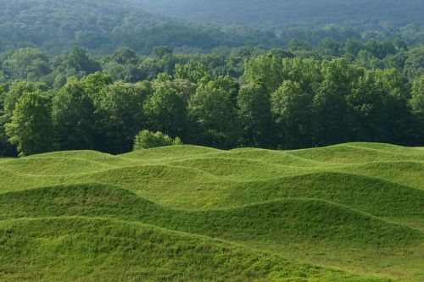
Architect: Maya Lin. Photo Credit: Jerry L. Thompson

Slide 60
Draft Concept B

Slide 61
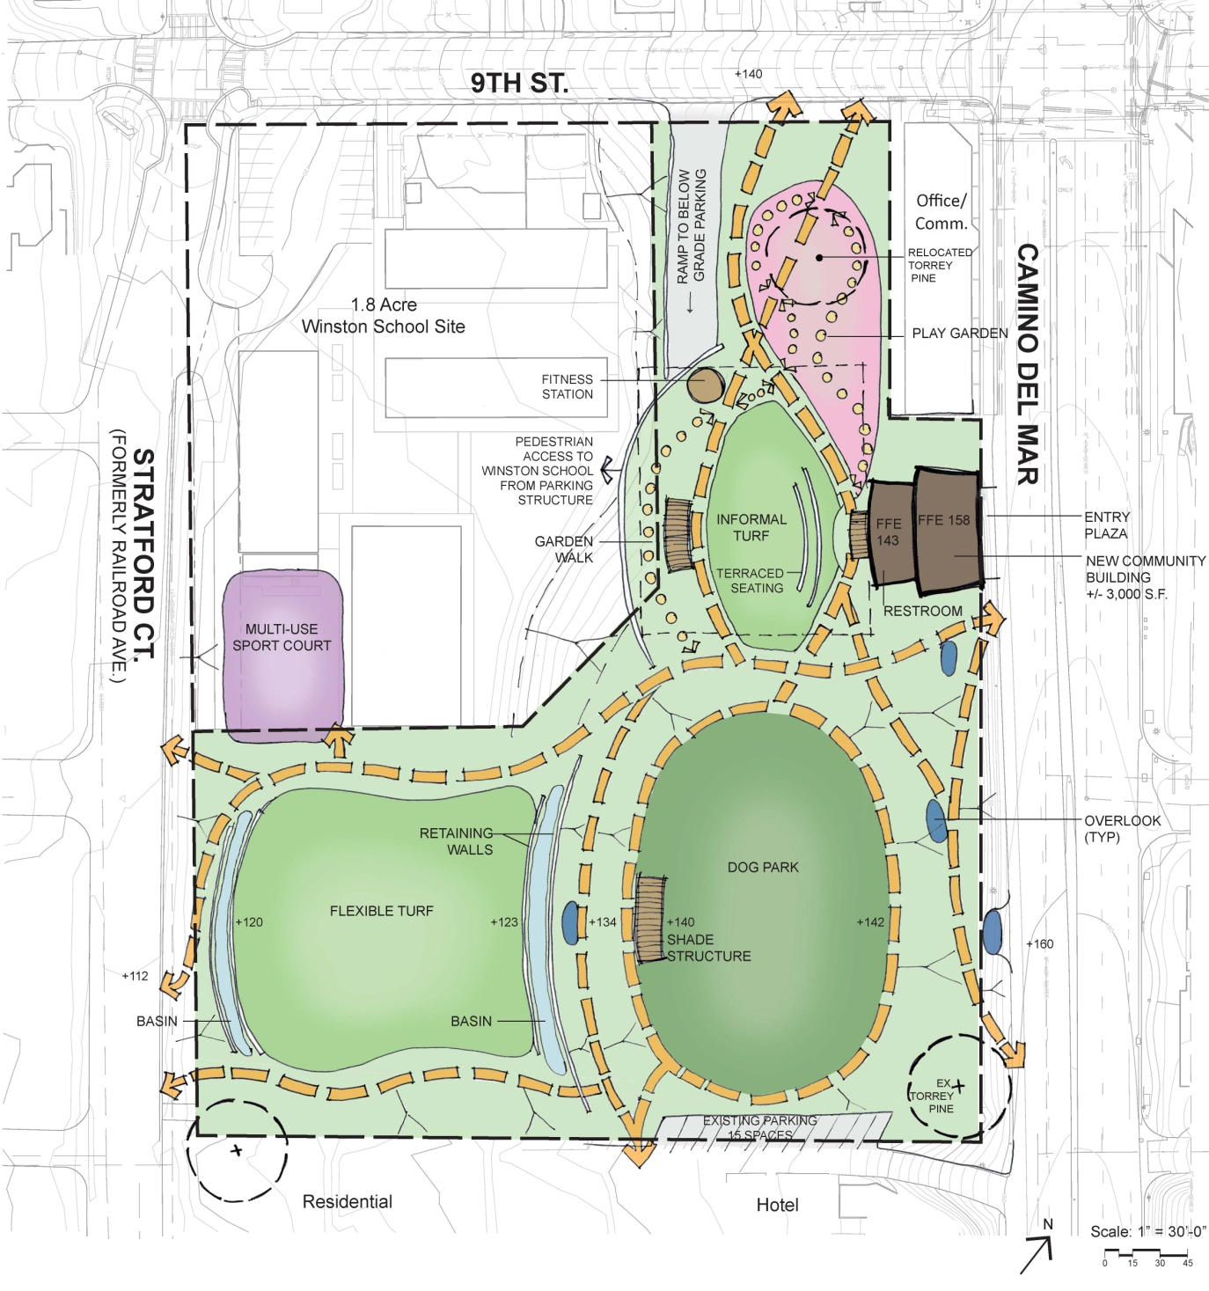
Draft Concept C
DRAFT PARK PROGRAM

Slide 62
Draft Concept C – Amenities Summary
New Community Building with indoor meeting/recreational space, restroom, and rooftop terrace (+/-3,000sf)
Below Grade Parking with Access from 9th (35 spaces), 15 spaces at hotel
Garden pathways with benches for sitting, enjoying views, reading, meditating, etc.
Off leash dog area (no obvious or rigid fences)
Open turf for flexible play
Children’s discovery play garden
Trees and structures for shade
Restroom in new building
Potential Joint Use Multi-Use Sport Court
Fitness Stations
Informal Amphitheatre
Interpretive education/Garden Walk
DRAFT PARK PROGRAM
TIER 1
TIER 2
TIER 3

Slide 63
Draft Concept C

Slide 64
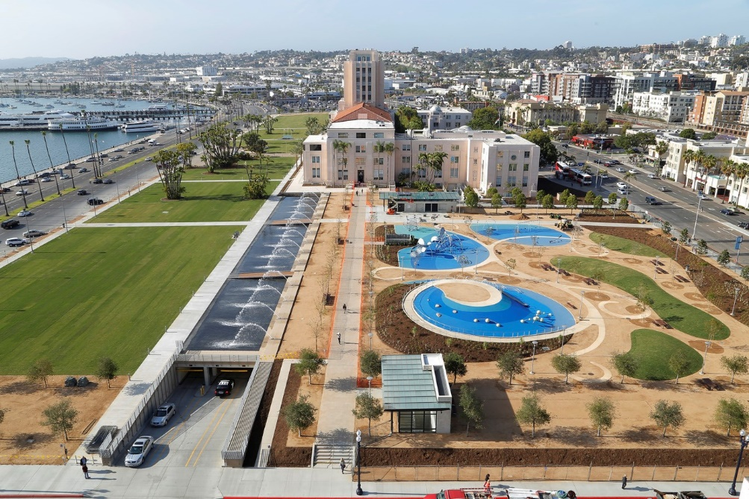
ENTRANCE
PARKING

Slide 65
Draft Concept C
35 below grade parking
15 Parking Spaces
Parking - 50 Total

Slide 66
Draft Concept C

Slide 67
Draft Concept C

Slide 68
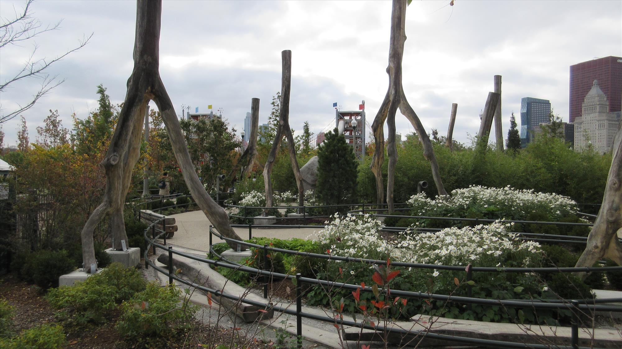

Slide 69
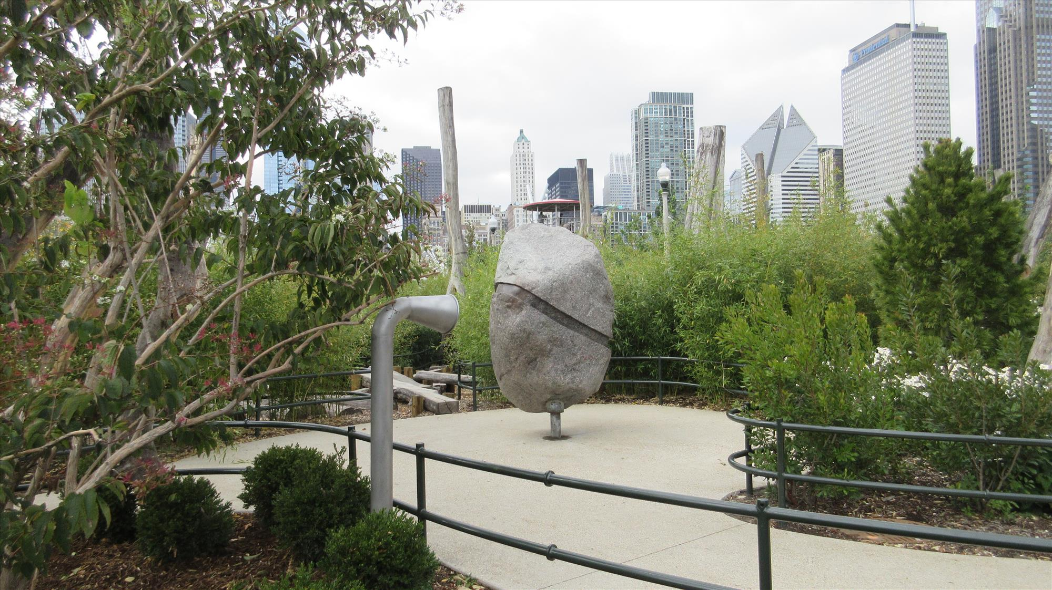

Slide 70
Draft Concept C

Slide 71
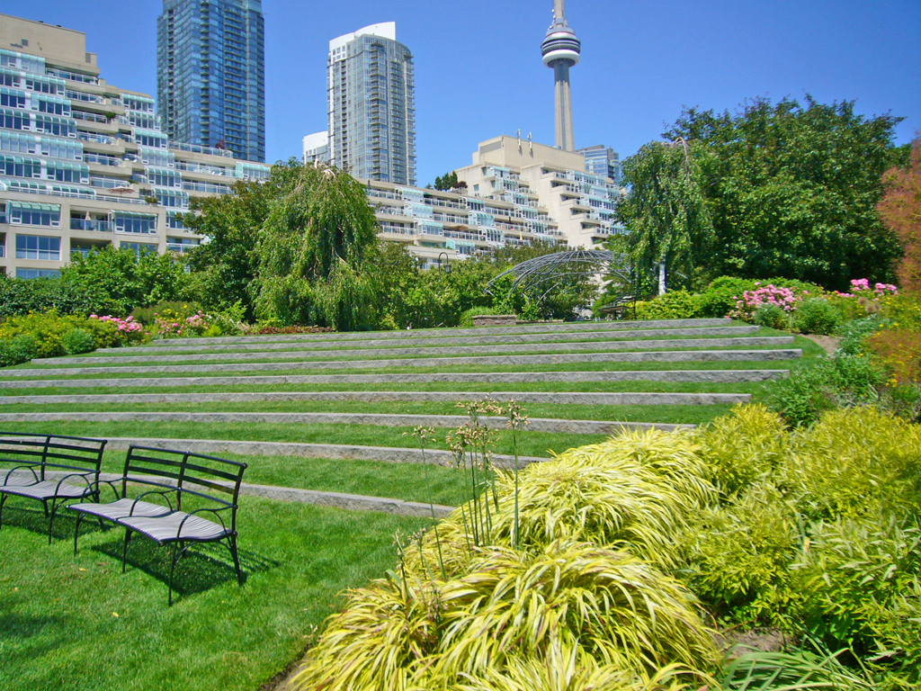

Slide 72
Architect: Enderstudio
Architect: Enderstudio

Slide 74
Draft Concept C

Slide 75
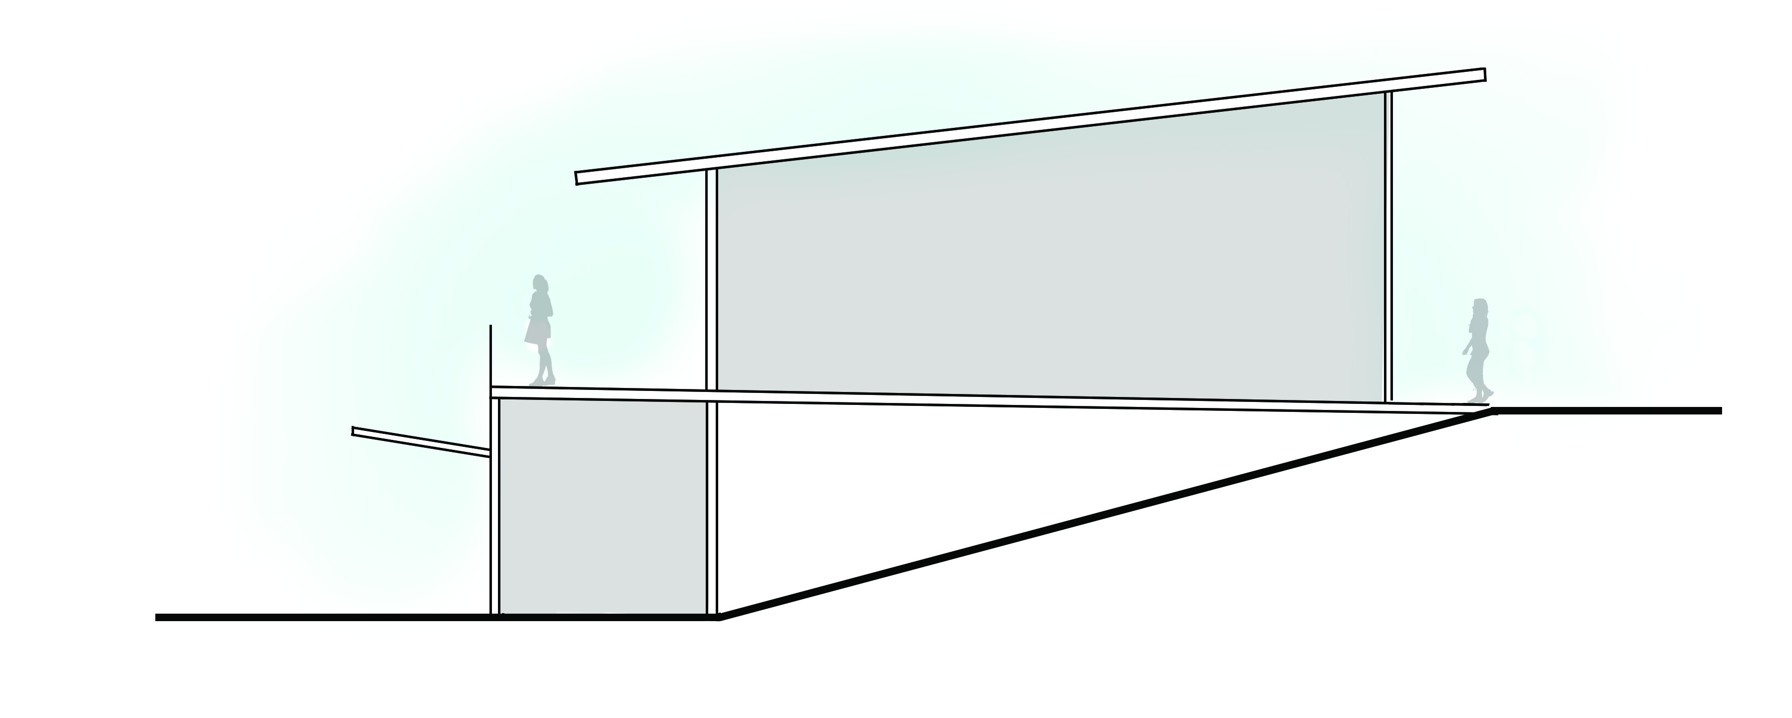
Draft Concept C - Community Building stepped into slope
CAMINO DEL MAR
FFE 158
FFE 143

Slide 76
Draft Concept C

Slide 78
Draft Concept C

Slide 79
Draft Concept C

Slide 80
Draft Concept C
135’ x 200’
160’ x 150’
(Existing 215’ x 175’)

Slide 81

Notes:
Existing park – shared space

Slide 82
FENCE DOWN SLOPE
“Ha-Ha” Fence on Slope
Notes:
Edge treatment

Slide 83



Photo Credit :Saskatchewan River Sturgeon Mgmt. Board
Notes:
http://www.saskriversturgeon.ca/sturgeon_recovery/education/

Slide 84
Draft Concept C

Slide 85
Photo Credit: Mark Ylen/Democrat Herald

Slide 86
Draft Concept C

Slide 87
4
CONCLUSION & DISCUSSION
Draft Concept A
Draft Concept B
Draft Concept C

